Slide 1

Customer Shopping Behavior Analysis
This project analyzes customer shopping behavior using transactional data from 3,900 purchases. Our goal is to uncover insights into spending patterns, customer segments, product preferences, and subscription behavior to guide strategic business decisions.

Slide 2

Project Overview
1
2
Data-Driven Insights
Strategic Guidance
Analyze 3,900 purchases to understand customer behavior.
Inform business decisions with findings on spending and preferences.
3
Key Areas
Focus on spending patterns, segments, product preferences, and subscriptions.

Slide 3

Dataset Summary
Key Features
Data Volume
Customer demographics (Age, Gender, Location, Subscription Status)
3,900 Rows
Purchase details (Item, Category, Amount, Season, Size, Color)
18 Columns
Shopping behavior (Discount, Promo Code, Previous Purchases, Frequency, Review Rating, Shipping Type)
Missing Data: 37 values in Review Rating

Slide 4
Exploratory Data Analysis (EDA)
01
02
03
Data Loading & Initial Exploration
Missing Data Handling
Column Standardization
Imputed missing Review Rating values using median per product category.
Renamed columns to snake_case for readability.
Imported dataset using pandas; checked structure and summary statistics.
04
05
Feature Engineering
Database Integration
Created age_group and purchase_frequency_days columns.
Loaded cleaned data into PostgreSQL for SQL analysis.

Slide 5

SQL Analysis: Key Business Questions
Revenue by Gender
High-Spending Discount Users
Male: $157,890, Female: $75,191
Identified 839 customers who used discounts but spent above average.
Top 5 Products by Rating
Shipping Type Comparison
Gloves (3.86), Sandals (3.84), Boots (3.82), Hat (3.8), Handbag (3.78)
Express: $60.48 avg, Standard: $58.46 avg

Slide 6
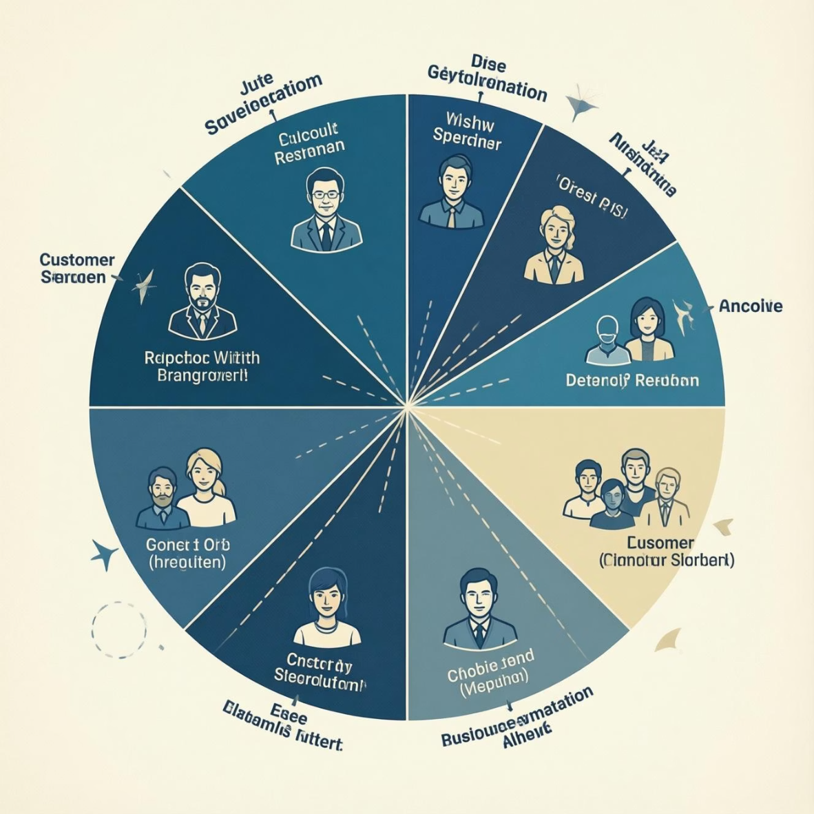
SQL Analysis: Subscription & Segmentation
Subscribers vs. Non-Subscribers
Customer Segmentation
No
2847
$59.87
$170,436
Loyal
3116
Yes
1053
$59.49
$62,645
Returning
701
Repeat Buyers & Subscriptions
New
83
Customers with >5 purchases: Yes (958), No (2518)

Slide 7

SQL Analysis: Product & Revenue
Discount-Dependent Products
Top 3 Products per Category
Hat: 50%
Accessories: Jewelry, Sunglasses, Belt
Sneakers: 49.66%
Clothing: Blouse, Pants, Shirt
Coat: 49.07%
Footwear: Sandals, Shoes, Sneakers
Sweater: 48.17%
Outerwear: Jacket
Pants: 47.37%
Revenue by Age Group
Young Adult: $62,143
Middle-aged: $59,197
Adult: $55,978
Senior: $55,763

Slide 8
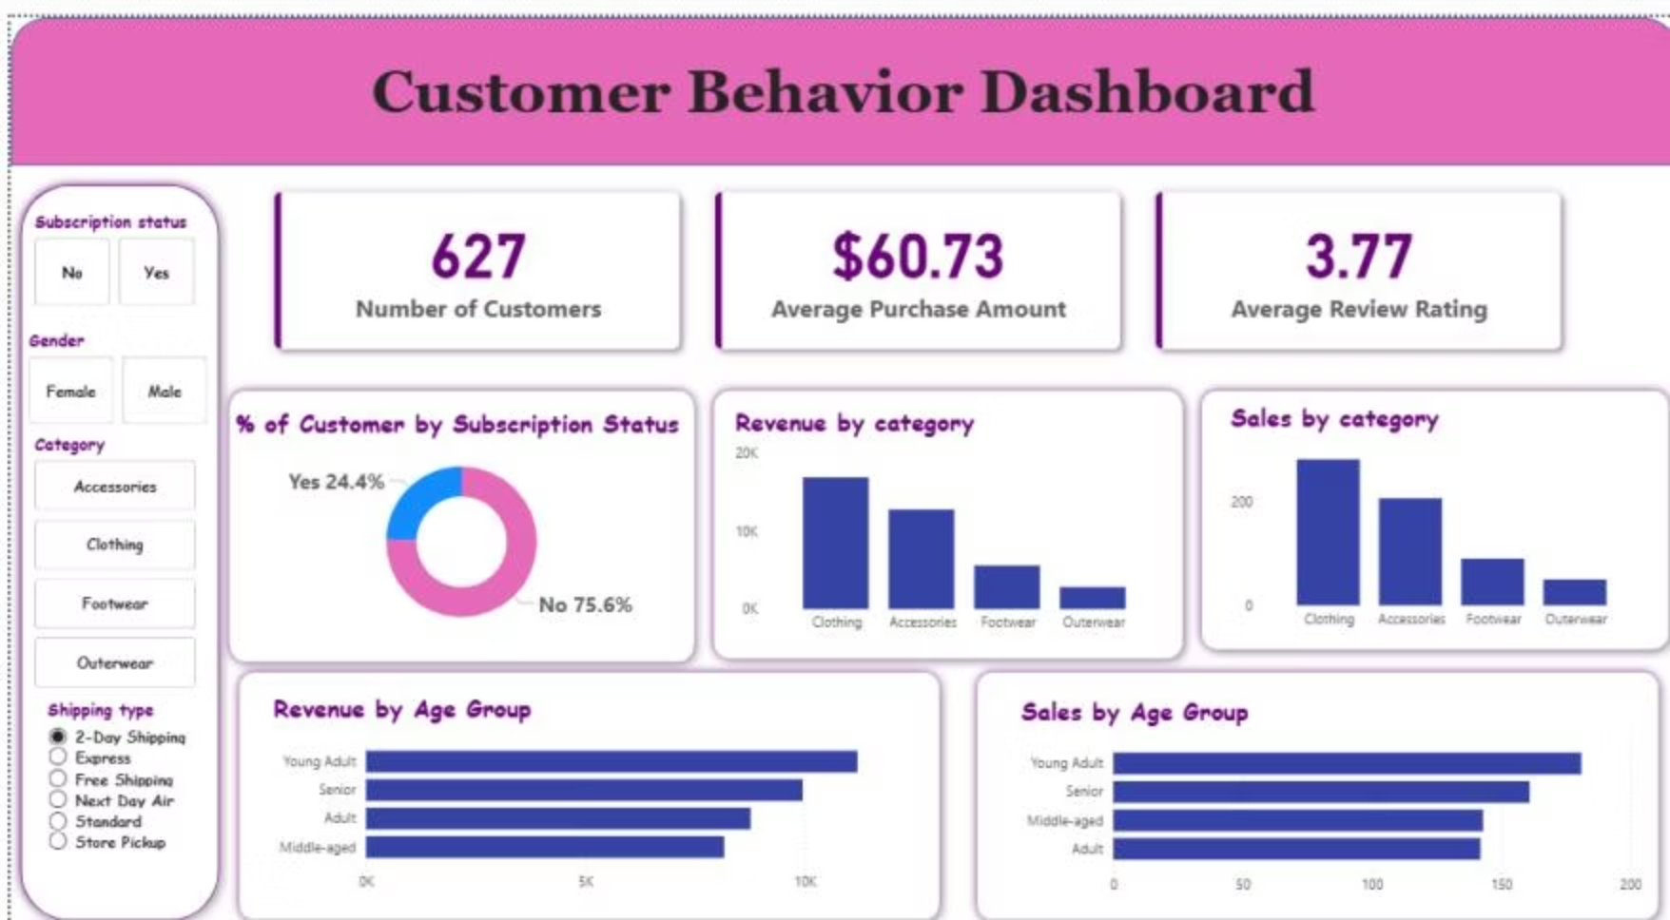

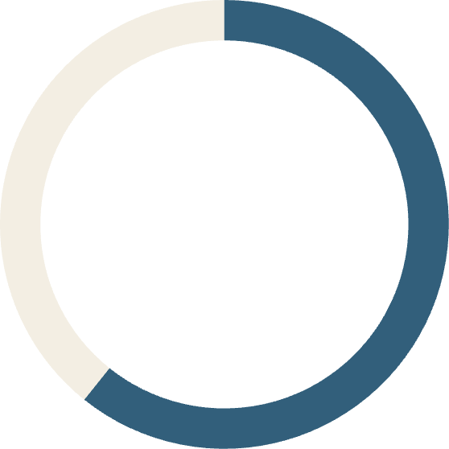

Power BI Dashboard
An interactive dashboard was built in Power BI to present insights visually.
627
$60.73
3.77
Number of Customers
Average Purchase Amount
Average Review Rating

Slide 9
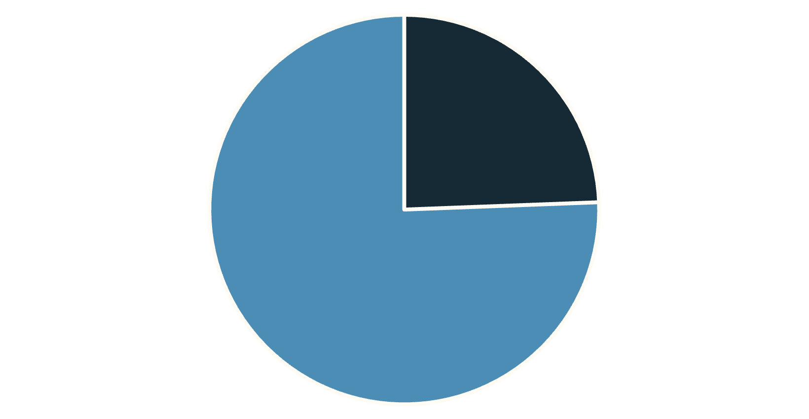
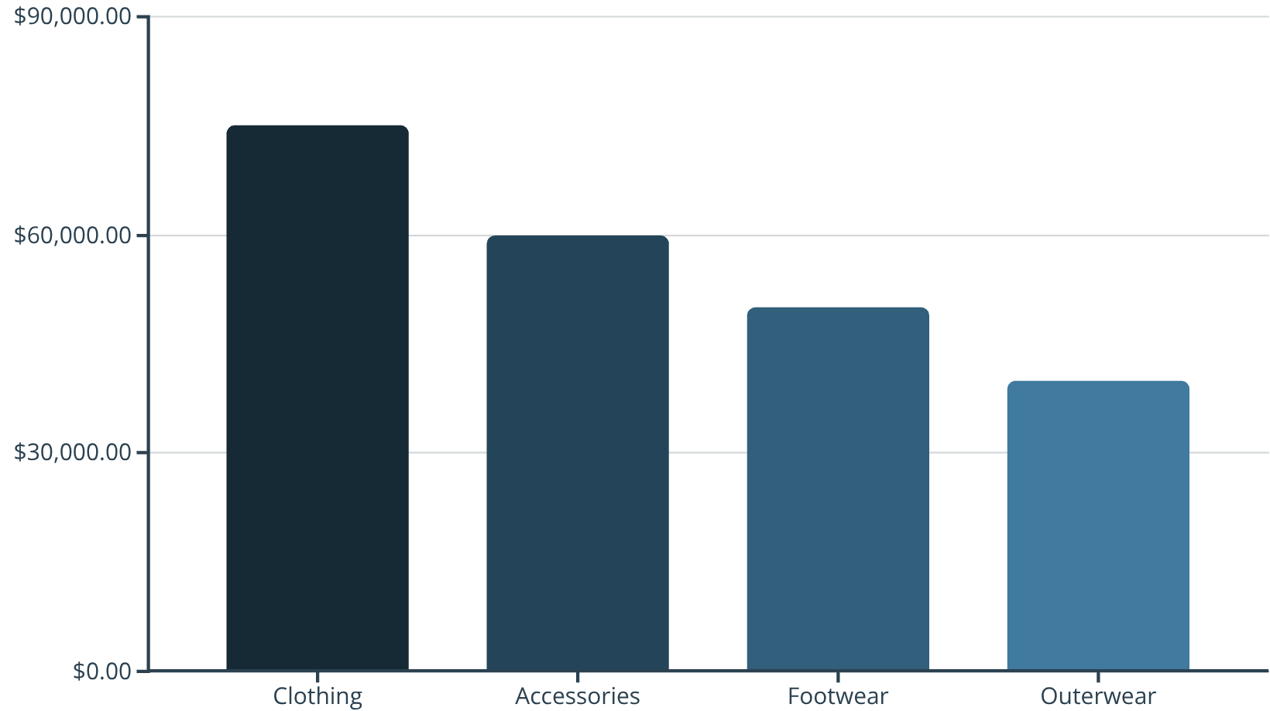
Dashboard Highlights
Subscription Status
Revenue by Category
Yes
No

Slide 10

Business Recommendations
Loyalty Programs
Implement tiered programs for high-value customer retention.
Discount Optimization
Use category-specific elasticity to refine discounting strategies.
Targeted Campaigns
Introduce seasonal campaigns to capture peak demand shifts.
Digital Payments
Promote incentives to streamline the checkout experience.
Cross-Selling
Explore bundles to increase average order value.

